Slide 1
Monday – Exam 1
This Exam is Open Resources, but Individual.
You may use electronic resources (calculators, python, etc.) to perform operations.
You will submit your “proof of work” as an external file to Exam 1 Scratch Notes on Canvas to be considered for partial credit
You can submit any numeric answers as decimals with at least two digits past the decimal if rounded.
If you get to Question 13 and it is asking for a number, raise your hand.

Slide 2
Wednesday

Slide 3
Course Logistics
Problem Set 4 – Due Friday, March 24
That’s right before Spring Break!
PS5 will be available over Spring Break, but Spring Break is not part of the expected weeks of completion time
No Participation this week – new one on 3/20
Project Milestone 3 – On Canvas!

Slide 4
Exam 1 Results
You should be able to see your grade, your submitted exam, correct / incorrect, and notes (if any)
Please sanity check that your results make sense
Problem 5 (should have a score)
Problem 11 (autograde bug)
Problem 14 (BONUS) – if you got it right you should have 10 points out of 0.

Slide 5
Back to Neural Nets

Slide 6
Where We Are
1
1
b¹
b²
Feed-Forward Neural Network
Initialize Weights
SGD loop (for random example):
forward propagate for activations
backward propagate for derivatives
update weights
-1
-1
$${\begin{aligned}\text{δ}\text{=16 ∗ 1} \\ \text{δ}=16\end{aligned}}^{}$$
-1
-1
Z=0
a=0
1
1
Y₁
z=4
a=4
X₁
-1
-2
-1
2
-3
z=1
a=1
1
$${\begin{aligned}\text{δ}\text{=16 ∗ 0 } \\ \text{δ}=0\end{aligned}}^{}$$
Cost
16
1
-1
2
Y₂
z=-4
a=0
X₂
1
3
z=2
a=2
-1
3
W¹
W²
$${\text{δ}}^{L}={\text{▽}}_{a^{L}}\text{C}\text{ ⊙} g′(z^{L})$$

Slide 7
Outstanding Issues with Neural Networks
Starting Values
Standard SGD Issues – Local vs. Global Minimum
Stopping Point

Slide 8
Neural Networks – Initializing Weights
1
1
b¹
b²
Initialize with all 0s?
0
0
0
0
Y₁
X₁
0
0
0
0
0
0
0
0
0
0
Y₂
X₂
0
0
0
W¹
W²

Slide 9
Neural Networks – Initializing Weights
1
1
b¹
b²
Initialize with all 0s?
Locks Up
Initialize with all 1s?
Y₁
X₁
Y₂
X₂
W¹
W²

Slide 10
Neural Networks – Initializing Weights
1
1
b¹
b²
Initialize with all 0s?
Locks Up
Initialize with all 1s?
Works fine…
Initialize with small random weights?
Y₁
X₁
Y₂
X₂
W¹
W²

Slide 11
Neural Networks – Initializing Weights
1
1
b¹
b²
Initialize with all 0s?
Locks Up
Initialize with all 1s?
Works fine…
Initialize with small random weights?
Works fine…
Y₁
X₁
Y₂
X₂
W¹
W²

Slide 12
Outstanding Issues with Neural Networks
Starting Values
Standard SGD Issues – Local vs. Global Minimum
Stopping Point

Slide 13
Neural Networks – Convex Function?
1
1
b¹
b²
Local vs. Global Minimum?
What happens if I swap Y₁ and Y₂?
Y₁
X₁
Y₂
X₂
W¹
W²

Slide 14
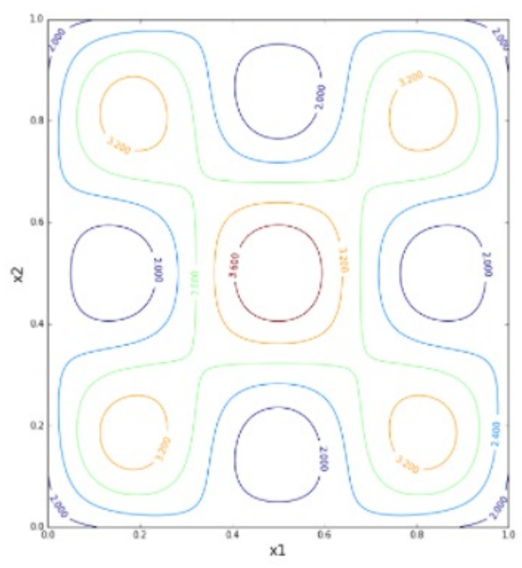
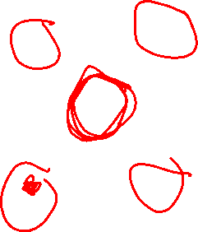
Neural Networks – Convex Function?
1
1
b¹
b²
Local vs. Global Minimum?
Y₁
X₁
Y₂
X₂
W¹
W²

Slide 15
Neural Networks – Overcoming Local Minimum
Multiple training iterations
Initialize with different random variables
Add a noise term to weights
Weights fluctuate even without gradient
Momentum
Increase weight adjustment rate
1
1
b¹
b²
Y₁
X₁
Y₂
X₂
W¹
W²

Slide 16
Neural Networks – Initializing Weights
1
1
b¹
b²
Initialize with all 0s?
Locks Up
Initialize with all 1s?
Works fine…
Initialize with small random weights?
Works better…
Y₁
X₁
Y₂
X₂
W¹
W²

Slide 17
Neural Networks – Weight Explosions
1
1
b¹
b²
How do we combat weights growing out of control?
Y₁
X₁
Y₂
X₂
W¹
W²

Slide 18
Neural Networks – Weight Explosions
1
1
b¹
b²
How do we combat weights growing out of control?
Regularization
L2-Norm
$$C=C_{0}+\frac{\text{λ}}{2}\sum_{w}{w^{2}}$$
L1-Norm
$$C=C_{0}+\frac{\text{λ}}{2}\sum_{w}{w^{1}}$$
Y₁
X₁
Y₂
X₂
W¹
W²

Slide 19
Outstanding Issues with Neural Networks
Starting Values
Standard SGD Issues – Local vs. Global Minimum
Stopping Point

Slide 20
Neural Networks – Stopping Point
1
1
b¹
b²
Y₁
X₁
Y₂
X₂
W¹
W²

Slide 21
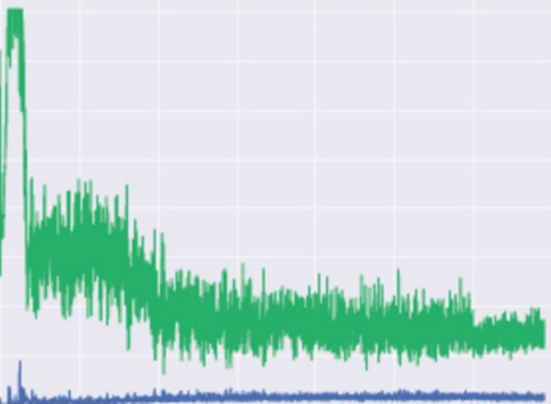
Neural Networks – Stopping Point
1
1
b¹
b²
Same as any SGD Problem, stop when accuracy on validation set stops improving, or at some sort of threshold.
Y₁
X₁
Y₂
X₂
W¹
W²

Slide 22
Convolutional Neural Networks

Slide 23
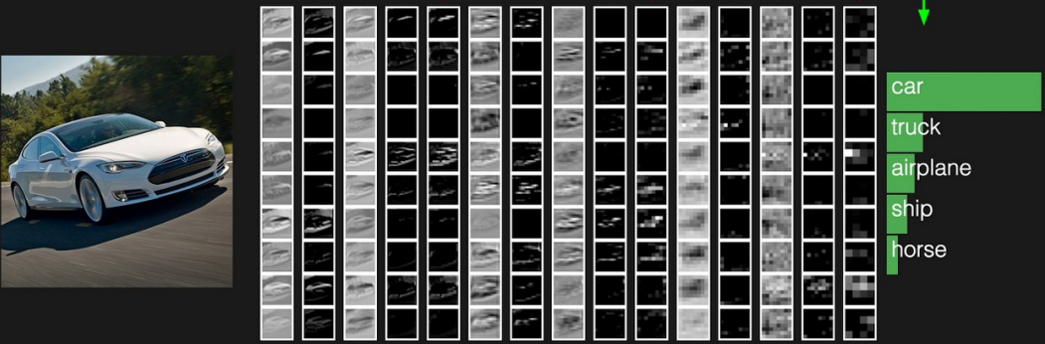
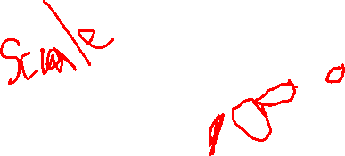
Neural Network – Object Recognition

Slide 24
Basic Feed-Forward Neural Networks
1
1
b¹
b²
Every element of a layer is connected to every element of the following layer
X₁
Y₁
X₂
Y₂
W¹
W²

Slide 25
Basic Feed-Forward Neural Networks
1
1
b¹
b²
Every element of a layer is connected to every element of the following layer
Ordering, neighboring doesn’t matter…
Y₁
X₂
Y₂
X₁
W¹
W²

Slide 26
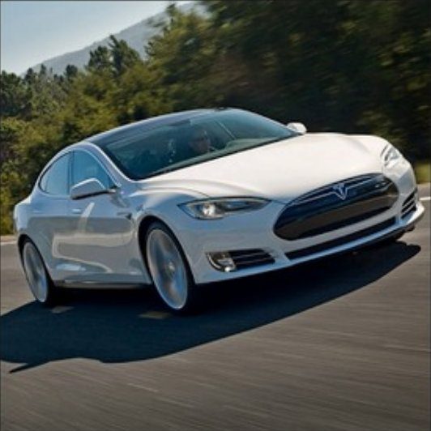

Slide 27
Convolution – CV in 15 minutes
Mathematically combining nearby info
Found in Signals Processing / Computer Vision

Slide 28
Convolution
Initial Matrix
20 | 20 | 45 | 200
18 | 20 | 125 | 240
35 | 125 | 245 | 245
145 | 250 | 240 | 240

Slide 29
Convolution
Initial Matrix
Convolution Matrix
20 | 20 | 45 | 200
18 | 20 | 125 | 240
35 | 125 | 245 | 245
145 | 250 | 240 | 240
1 | 0 | 1
0 | 1 | 0
1 | 0 | 1

Slide 30
Convolution
Initial Matrix
Convolution Matrix
20 | 20 | 45 | 200
18 | 20 | 125 | 240
35 | 125 | 245 | 245
145 | 250 | 240 | 240
1 | 0 | 1
0 | 1 | 0
1 | 0 | 1

Slide 31
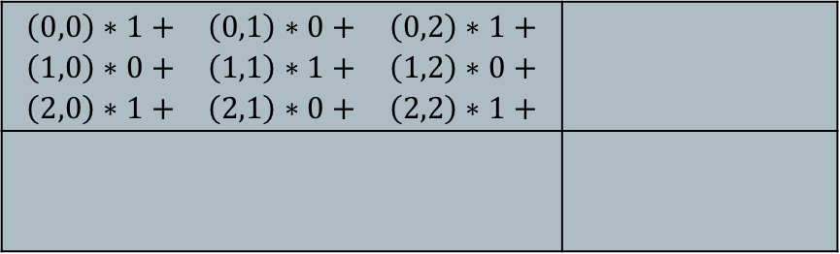
Convolution
Initial Matrix Output Matrix
Convolution Matrix
20 | 20 | 45 | 200
18 | 20 | 125 | 240
35 | 125 | 245 | 245
145 | 250 | 240 | 240
$$\begin{matrix}\left(0,0\right)∗1+ & \left(0,1\right)∗0+ & \left(0,2\right)∗1+ \\ \left(1,0\right)∗0+ & \left(1,1\right)∗1+ & \left(1,2\right)∗0+ \\ \left(2,0\right)∗1+ & \left(2,1\right)∗0+ & \left(2,2\right)∗1+\end{matrix}$$
1 | 0 | 1
0 | 1 | 0
1 | 0 | 1

Slide 32
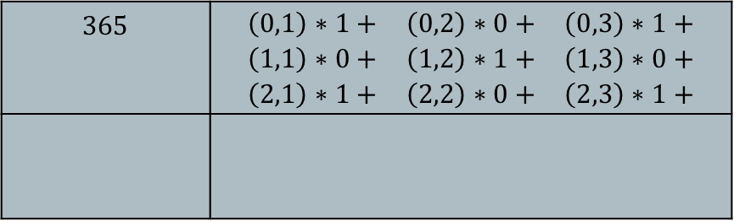
Convolution
Initial Matrix Output Matrix
Convolution Matrix
20 | 20 | 45 | 200
18 | 20 | 125 | 240
35 | 125 | 245 | 245
145 | 250 | 240 | 240
$$365$$ | $$\begin{matrix}\left(0,1\right)∗1+ & \left(0,2\right)∗0+ & \left(0,3\right)∗1+ \\ \left(1,1\right)∗0+ & \left(1,2\right)∗1+ & \left(1,3\right)∗0+ \\ \left(2,1\right)∗1+ & \left(2,2\right)∗0+ & \left(2,3\right)∗1+\end{matrix}$$
1 | 0 | 1
0 | 1 | 0
1 | 0 | 1

Slide 33
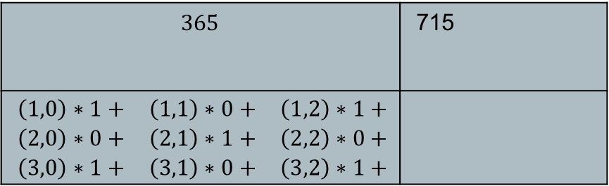
Convolution
Initial Matrix Output Matrix
Convolution Matrix
20 | 20 | 45 | 200
18 | 20 | 125 | 240
35 | 125 | 245 | 245
145 | 250 | 240 | 240
$$365$$ | 715
$$\begin{matrix}\left(1,0\right)∗1+ & \left(1,1\right)∗0+ & \left(1,2\right)∗1+ \\ \left(2,0\right)∗0+ & \left(2,1\right)∗1+ & \left(2,2\right)∗0+ \\ \left(3,0\right)∗1+ & \left(3,1\right)∗0+ & \left(3,2\right)∗1+\end{matrix}$$
1 | 0 | 1
0 | 1 | 0
1 | 0 | 1

Slide 34
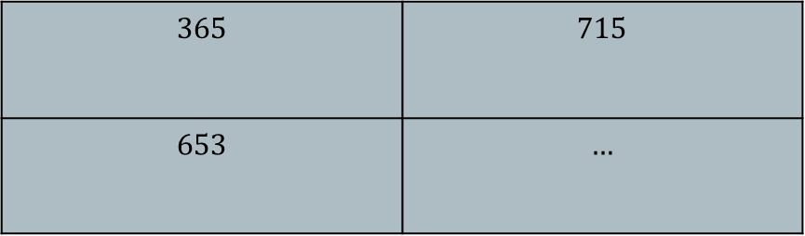
Convolution
Initial Matrix Output Matrix
Convolution Matrix
20 | 20 | 45 | 200
18 | 20 | 125 | 240
35 | 125 | 245 | 245
145 | 250 | 240 | 240
$$365$$ | $$715$$
$$653$$ | $$…$$
1 | 0 | 1
0 | 1 | 0
1 | 0 | 1

Slide 35
Convolution
20 | 20 | 45 | 200
18 | 20 | 125 | 240
35 | 125 | 245 | 245
145 | 250 | 240 | 240
1 | 0 | 1
0 | 1 | 0
1 | 0 | 1
$$\text{20 + 45 + 20 + 35 + 245}$$ | $$20+200+125+125+245$$
… | …

Slide 36
Convolution Matrices
Binary, e.g. diagonal Random
Intentional e.g. sombrero / hat
1 | 0 | 1
0 | 1 | 0
1 | 0 | 1
1 | -2 | 5
-3 | 1 | .4
-1.7 | -4 | 3
1 | 1 | 1
1 | -5 | 1
1 | 1 | 1

Slide 37
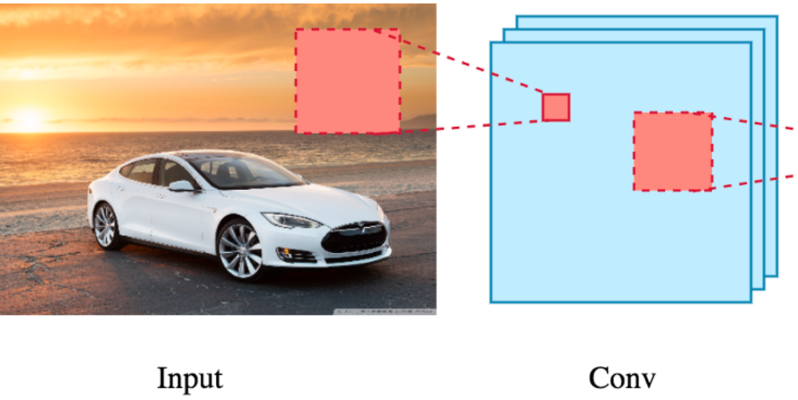
Data Convolution

Slide 38
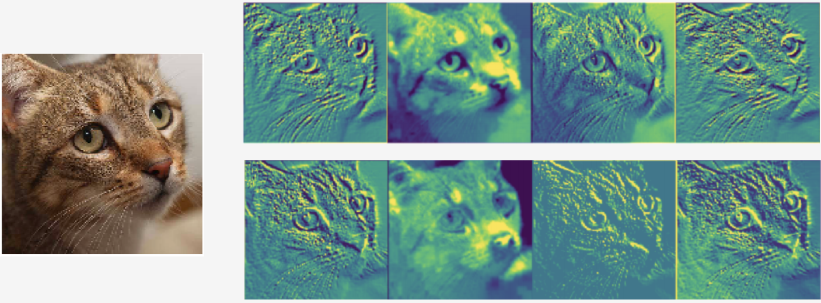
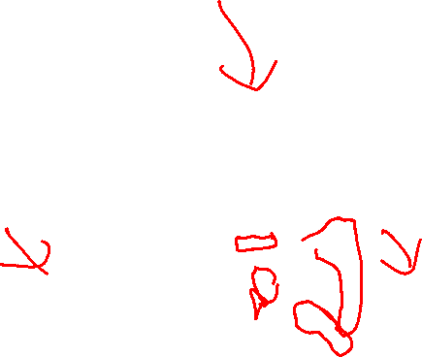
Data Convolution
First Layer Convolutions

Slide 39
Pooling
Reduce Complexity by combining neighboring terms
20 | 20 | 45 | 200
18 | 20 | 125 | 240
35 | 125 | 245 | 245
145 | 250 | 240 | 240

Slide 40
Pooling
Reduce Complexity by combining neighboring terms
e.g. max pool
20 | 20 | 45 | 200
18 | 20 | 125 | 240
35 | 125 | 245 | 245
145 | 250 | 240 | 240
20 | 240
250 | 245

Slide 41
Pooling
Reduce Complexity by combining neighboring terms
e.g. max pool
Downsamples the image (to reduce complexity)
Allow neighboring features to interact (grow downstream receptive fields)
20 | 20 | 45 | 200
18 | 20 | 125 | 240
35 | 125 | 245 | 245
145 | 250 | 240 | 240
20 | 240
250 | 245

Slide 42
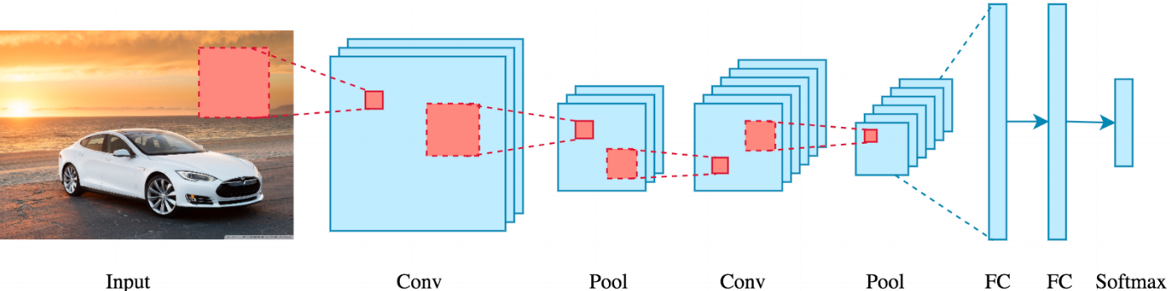
Convolution + Pooling

Slide 43
Improving Convolutions
SGD with Back Propagation
Details of implementation are beyond this course

Slide 44
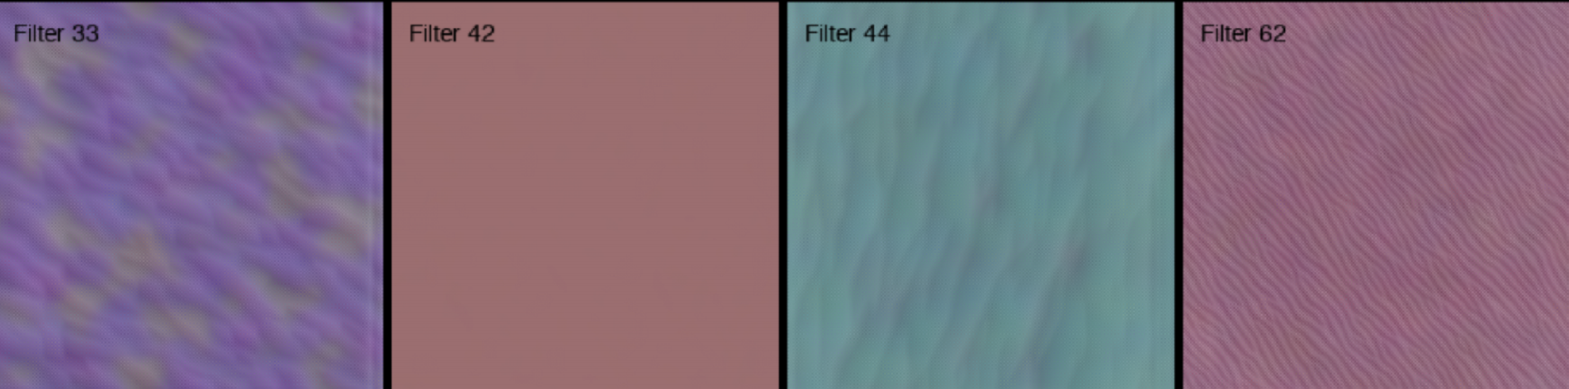
Convolution + Pooling – Multiple Iterations
Convolution Layer 1

Slide 45
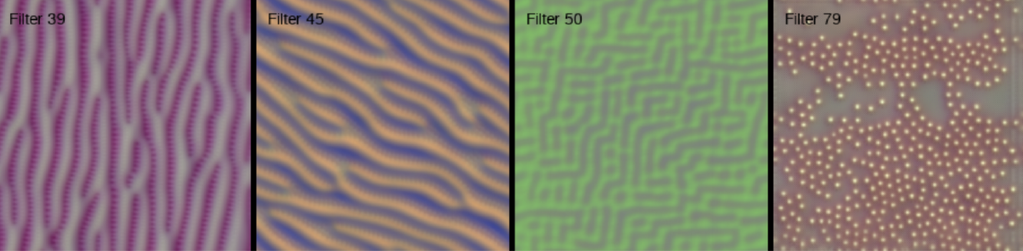
Convolution + Pooling – Multiple Iterations
Convolution Layer 2

Slide 46
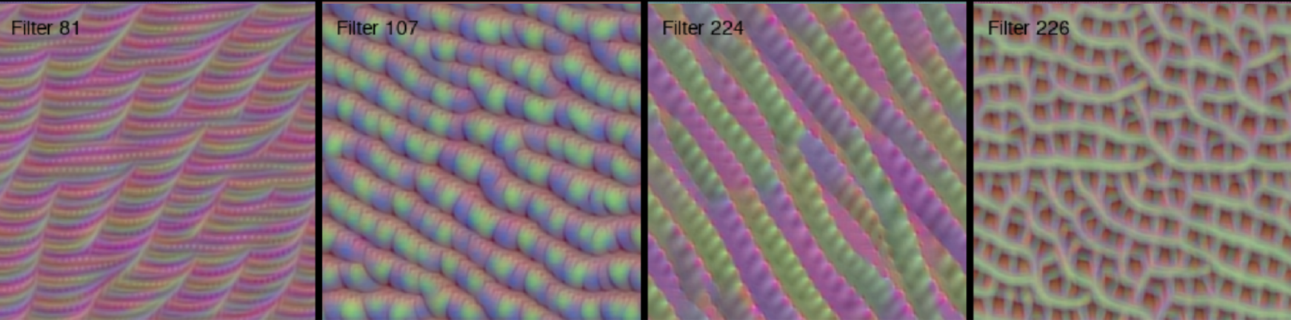
Convolution + Pooling – Multiple Iterations
Convolution Layer 3

Slide 47
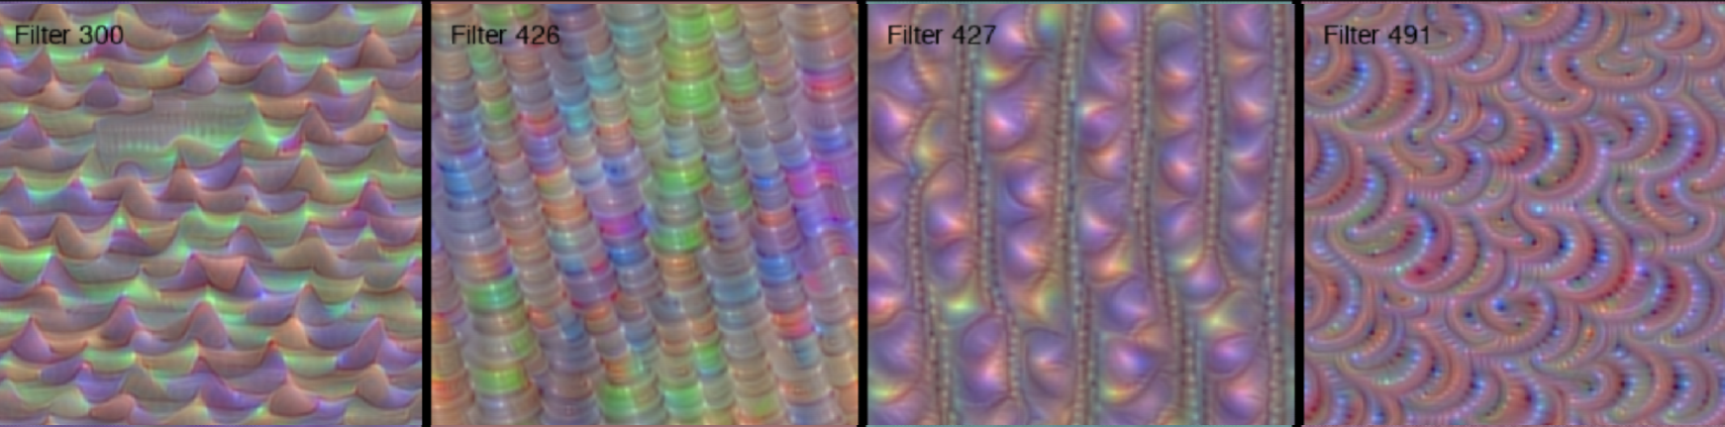
Convolution + Pooling – Multiple Iterations
Convolution Layer 4

Slide 48
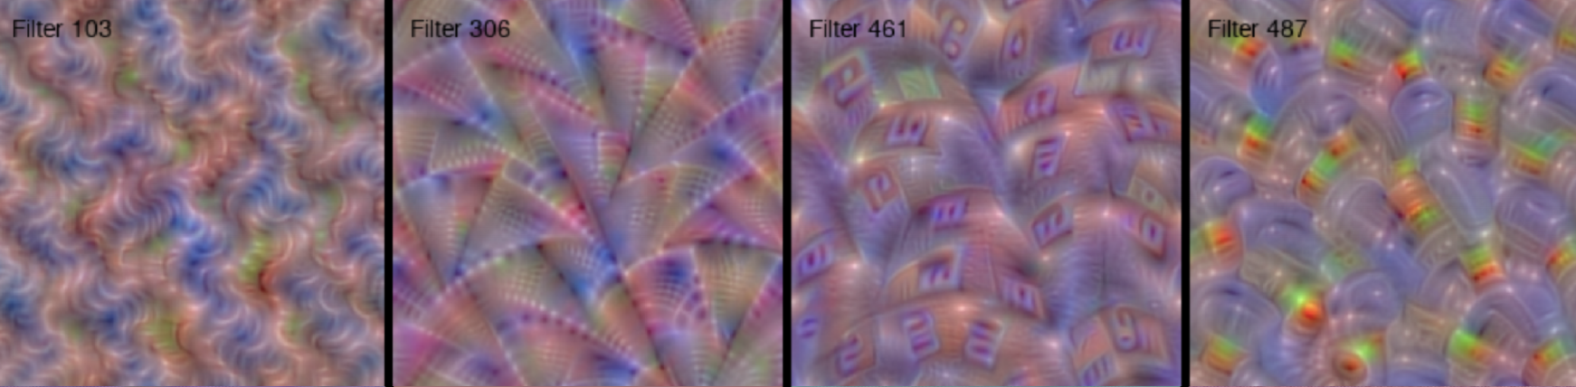
Convolution + Pooling – Multiple Iterations
Convolution Layer 5

Slide 49
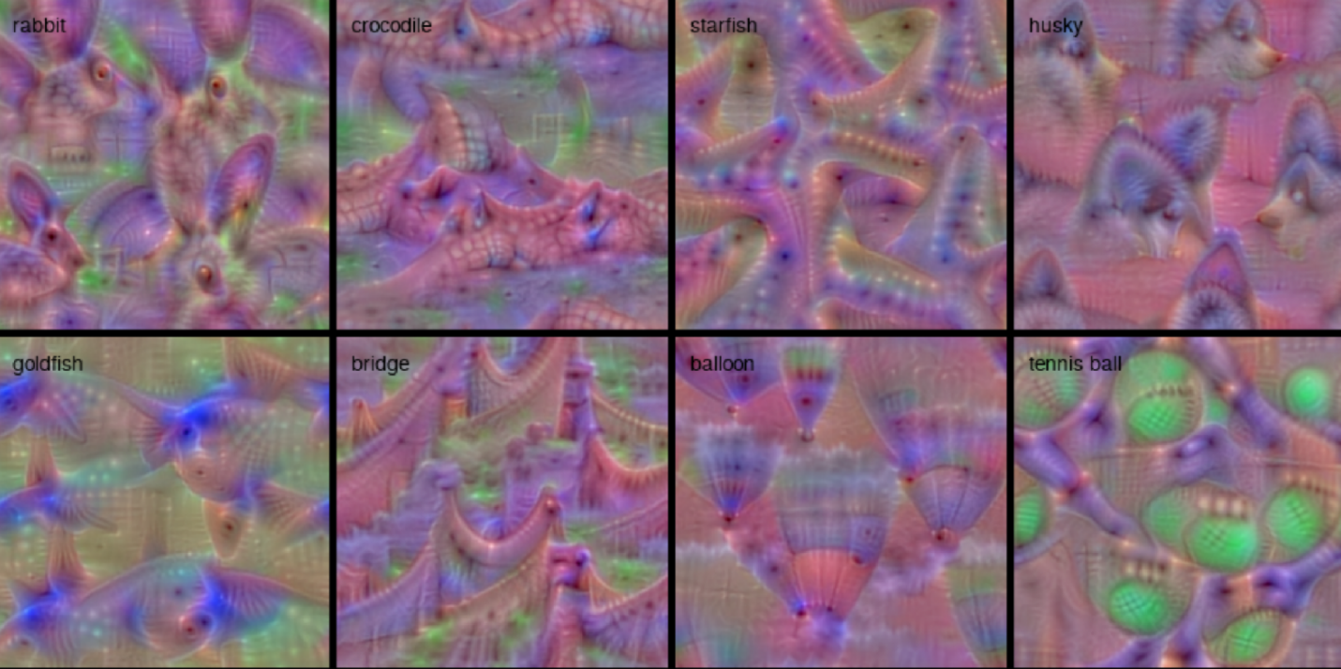
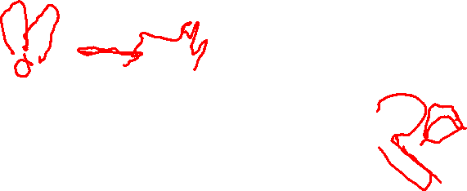
Convolution + Pooling – Multiple Iterations
Convolution Results

Slide 50
Convolutional Neural Network
Captures grid structure – retains it through layers

Slide 51
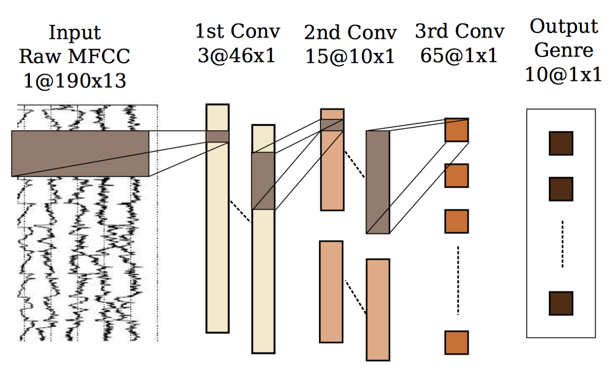
CNNs - Applications
Music – Genre Prediction

Slide 52
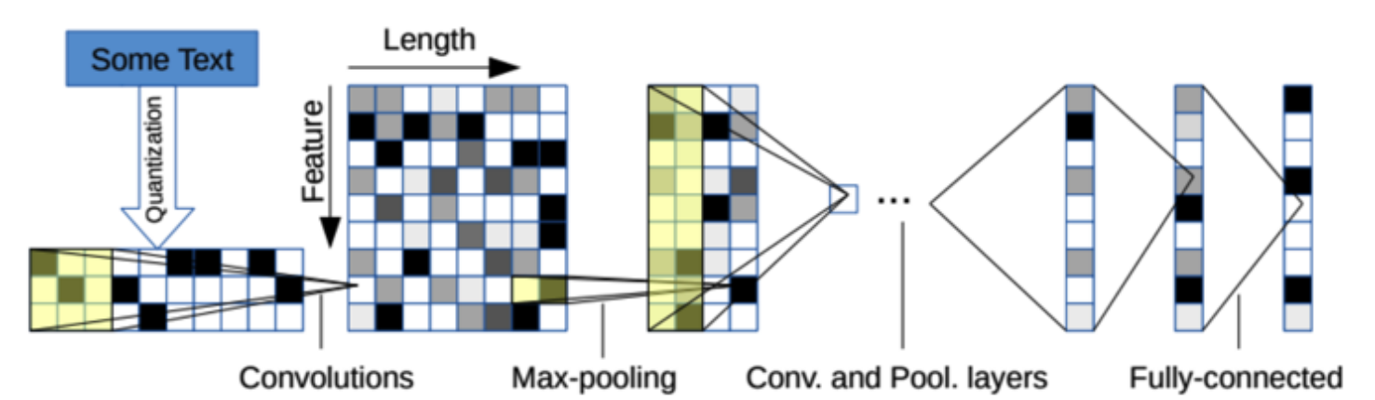

CNNs - Applications
NLP – Sentence Classification

Slide 53
Monday

Slide 54
Course Logistics
Sorry I had to miss Friday! We should still be on track
Problem Set 4 – Due Friday, March 24
That’s right before Spring Break!
PS5 will be available over Spring Break, but Spring Break is not part of the expected weeks of completion time
Participation to launch today (due after Spring Break, but don’t sleep on it!)
How did you feel about the SVM Participation’s flexibility?
Project Milestone 3 – On Canvas!

Slide 55
HW Interlude – CVXOPT Package

Slide 56
Best Decision Boundary
argmax_{w, b} (1 / ||w||) such that y_{i}(w^{T}x_{i} + b) >= 1 for i = {1,2,…,m}
Not Differentiable
argmin_{w, b} (||w||) such that y_{i}(w^{T}x_{i} + b) >= 1 for i = {1,2,…,m}
Not Differentiable
argmin_{w, b} (||w||²) such that y_{i}(w^{T}x_{i} + b) >= 1 for i = {1,2,…,m}
Convex + Differentiable
Requires a Convex quadratic program

Slide 57
Our New Formulation
argmin_{w, b} (||w||²) such that y_{i}(w^{T}x_{i} + b) >= 1 for i = {1,2,…,m}
min_{w} max_{α} L(w, α) = min_{w} max_{α} f(w) + ∑_{i=1…m} (α_{i}g_{i}(w)) - PRIMAL
Becomes
L_{D} = max_{α} min_{w,b} (½||w||² + ∑_{i=1…m} (α_{i} (1 – y_{i}(w^{T}x_{i} + b))))
DUAL
…
L(α_{i=1→m}) = (∑_{i} α_{i} − ½ ∑_{i,j} α_{i} α_{j} y_{i} y_{j} x_{i} · x_{j})

Slide 58
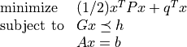
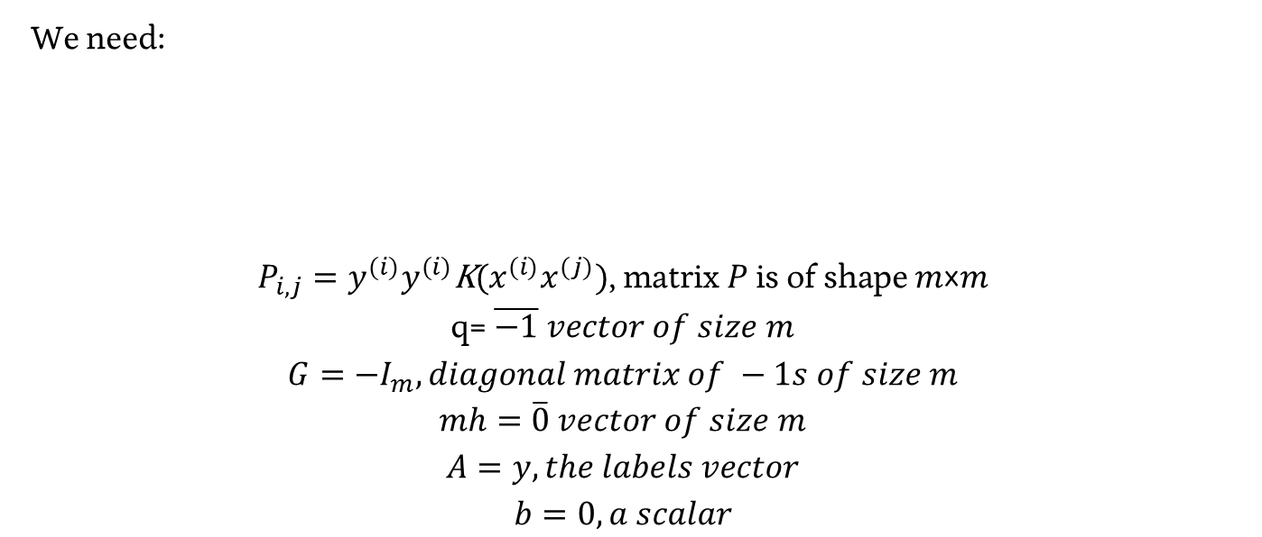

HW Interlude – CVXOPT Package
We need:
$$P_{i,j}=y^{(i)}y^{(i)}\text{K}\text{(}x^{(i)}x^{(j)})\text{, }\text{matrix} \text{P} \text{is} \text{of} \text{shape} \text{m}\text{×}\text{m}$$
$$\text{q}\text{= }\overline{−1} vector of size m$$
$$G={−I}_{m}, diagonal matrix of −1s of size m$$
$$mh=\overline{0} vector of size m$$
$$A=y, the labels vector$$
$$b=0, a scalar$$

Slide 59
Recurrent Neural Networks

Slide 60
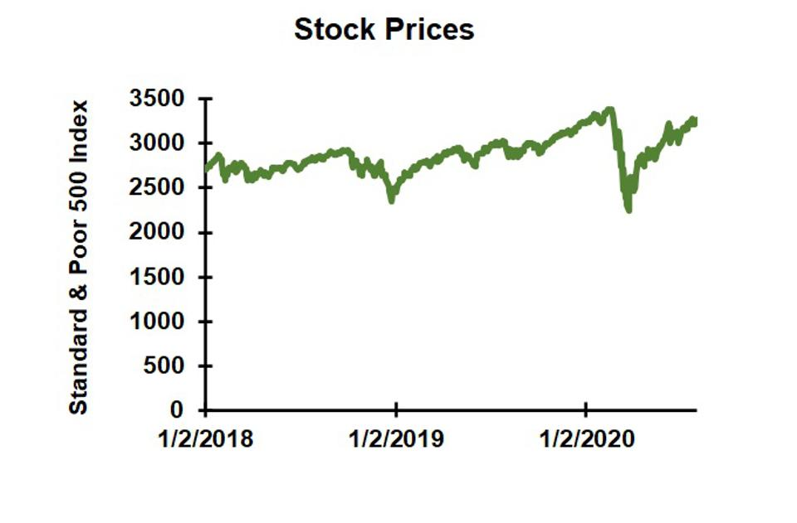
The Limits of Neural Networks

Slide 61
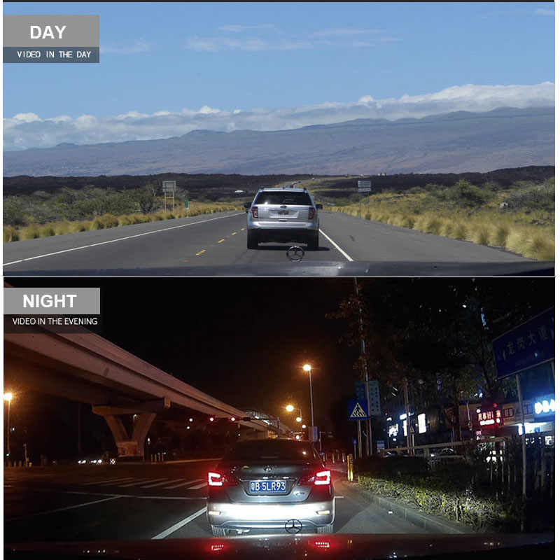

The Limits of Neural Networks
Notes:
https://ae01.alicdn.com/kf/H1d680fbff577471e8c928928f4e98280w/HGDO-H20-10-inch-Touch-screen-Car-DVR-Rear-View-Mirror-Dash-cam-Full-HD-Car.jpg_q50.jpg

Slide 62
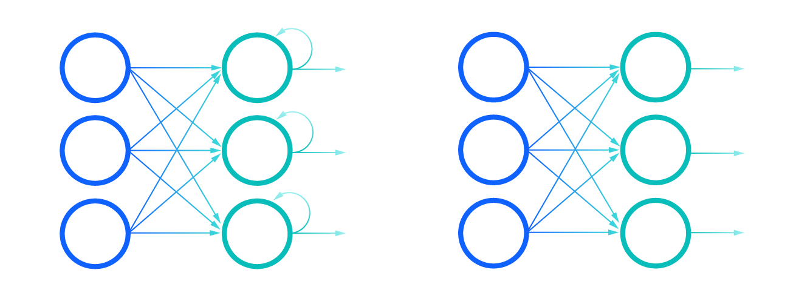
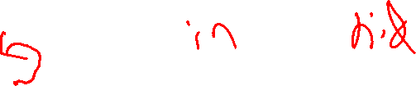
Recurrent NN vs. Feed-Forward (regular) NN

Slide 63
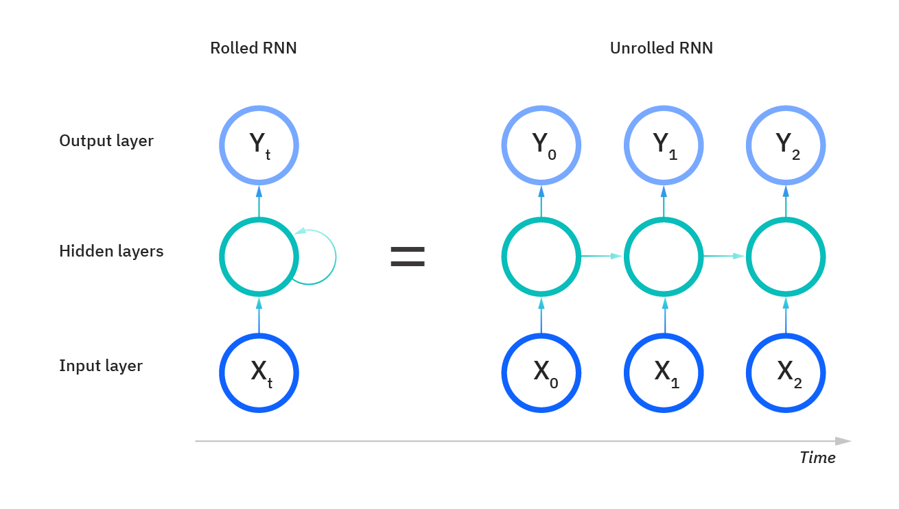
What’s Going On Here?

Slide 64
What’s Going On Here?
A Regular FF Neural Net
1
1
Y₁
X₁
Y₂
X₂

Slide 65
What’s Going On Here?
1
1
1
1
1
1

Slide 66
Wait… Why “LSTM” Layer?
1
1
We have LOTS of weights…
https://neptune.ai/blog/understanding-gradient-clipping-and-how-it-can-fix-exploding-gradients-problem
1
1
1
1

Slide 67
Wait… Why “LSTM” Layer?
1
1
We have LOTS of weights…
Each weight has a diminishing ability to impact
https://neptune.ai/blog/understanding-gradient-clipping-and-how-it-can-fix-exploding-gradients-problem
1
1
1
1

Slide 68
Wait… Why “LSTM” Layer?
1
1
We have LOTS of weights…
Each weight has a diminishing ability to impact
We have LOTS of layers!
https://neptune.ai/blog/understanding-gradient-clipping-and-how-it-can-fix-exploding-gradients-problem
1
1
1
1

Slide 69
Wait… Why “LSTM” Layer?
1
1
We have LOTS of weights…
Each weight has a diminishing ability to impact
We have LOTS of layers!
These layers are dependent
We cannot rely on intermediate steps for backpropogation…
Either “Vanishing” or “Exploding” gradients
https://neptune.ai/blog/understanding-gradient-clipping-and-how-it-can-fix-exploding-gradients-problem
1
1
1
1

Slide 70
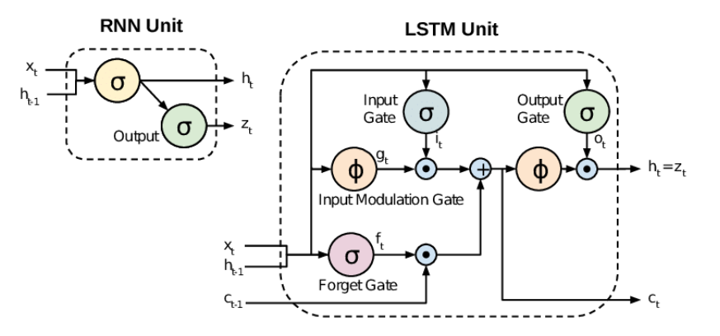
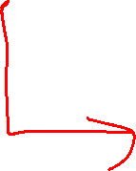
RNN vs. LSTM

Slide 71
Generative Adversarial Networks
GANs

Slide 72
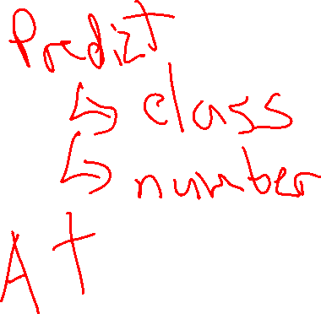
What Have We Used ML For?

Slide 73
What Have We Used ML For?
Supervised Learning
Distinguishing (e.g. Classification)
Estimating (e.g. Regression)
Using these results…
Analyzing Differences
More on this later
Recommendation

Slide 74
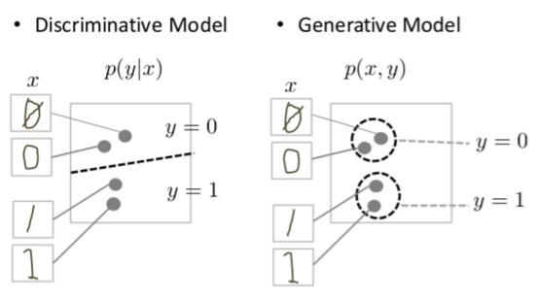
Generative Models
Create a “Generative Model”
Generative models can generate new data instances.
Discriminative models distinguish between different kinds of data instances.
https://developers.google.com/machine-learning/gan/generative

Slide 75
What Else Can Machines Do?
Make things!
Acting on explicit instructions
Acting on underlying pre-trained (generative) models

Slide 76
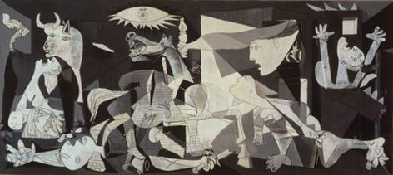

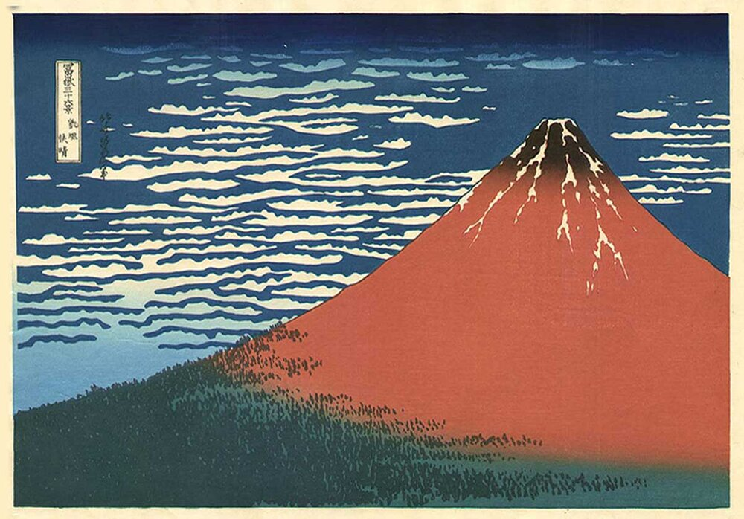
Art!
Pablo Picasso
Norman Rockwell Katsushika Hokusai
Notes:
https://render.fineartamerica.com/images/rendered/default/poster/8/10/break/images/artworkimages/medium/2/santa-at-the-map-norman-rockwell.jpg
https://en.wikipedia.org/wiki/Pablo_Picasso#/media/File:PicassoGuernica.jpg

Slide 77
Enter GANs!
“Generative adversarial networks (GANs) provide a way to learn deep representations without extensively annotated training data.”
“GANs may be used in a variety of applications, including image synthesis, semantic image editing, style transfer, image super-resolution and classification.”
https://arxiv.org/pdf/1710.07035.pdf

Slide 78
What are GANs For?
“GANs may be used in a variety of applications, including image synthesis, semantic image editing, style transfer, image super-resolution and classification.”
https://arxiv.org/pdf/1710.07035.pdf

Slide 79

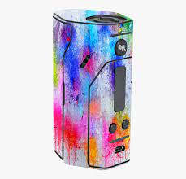
vs.
Painter
(G)enerator
Critic
(D)iscriminator

Slide 80
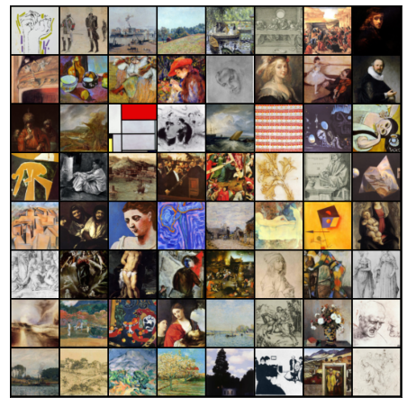
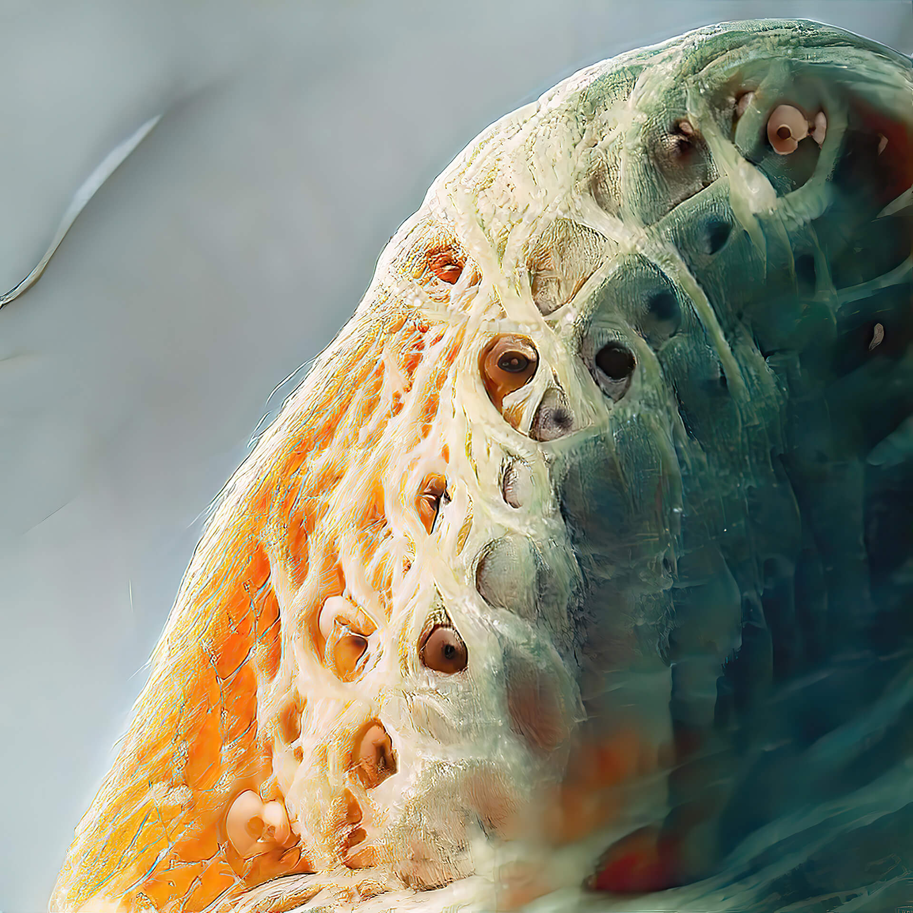
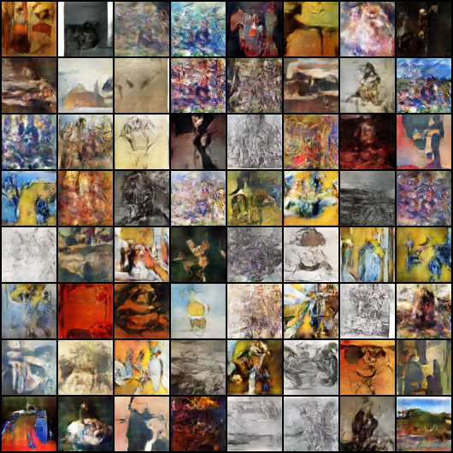
GAN Art
(Real)
Amir Zhussupov
Soham Nandi (GAN)
Notes:
https://www.stirworld.com/see-features-exploring-gan-art-with-amir-zhussupov
https://medium.com/analytics-vidhya/artgan-a-b77ecb1bc25a

Slide 81
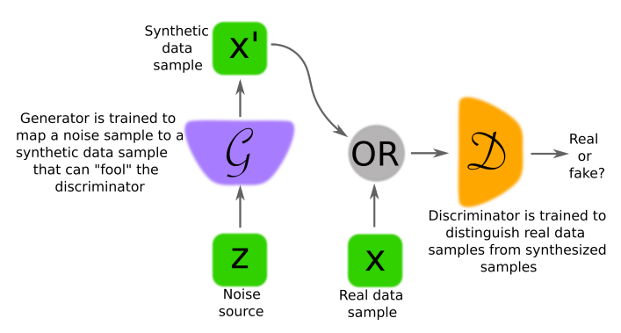
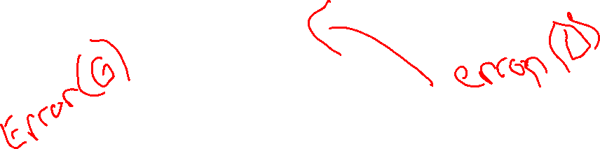
Architecture
https://arxiv.org/pdf/1710.07035.pdf

Slide 82
How does this work?
“… data generating distribution is often used to refer to the underlying probability density or probability mass function of observation data.”
https://arxiv.org/pdf/1710.07035.pdf

Slide 83
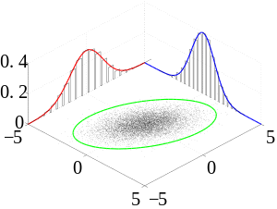
How does this work?
“… data generating distribution is often used to refer to the underlying probability density or probability mass function of observation data.”
https://arxiv.org/pdf/1710.07035.pdf

Slide 84
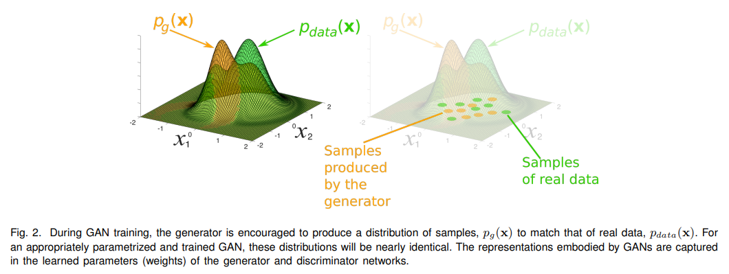

How does this work?

Slide 85
How does this work?
“… data generating distribution is often used to refer to the underlying probability density or probability mass function of observation data.”
“Whilst GANs don’t explicitly provide a way of evaluating density functions, for a generator-discriminator pair of suitable capacity, the generator implicitly captures the distribution of the data.”
https://arxiv.org/pdf/1710.07035.pdf
Notes:
https://en.wikipedia.org/wiki/Joint_probability_distribution

Slide 86
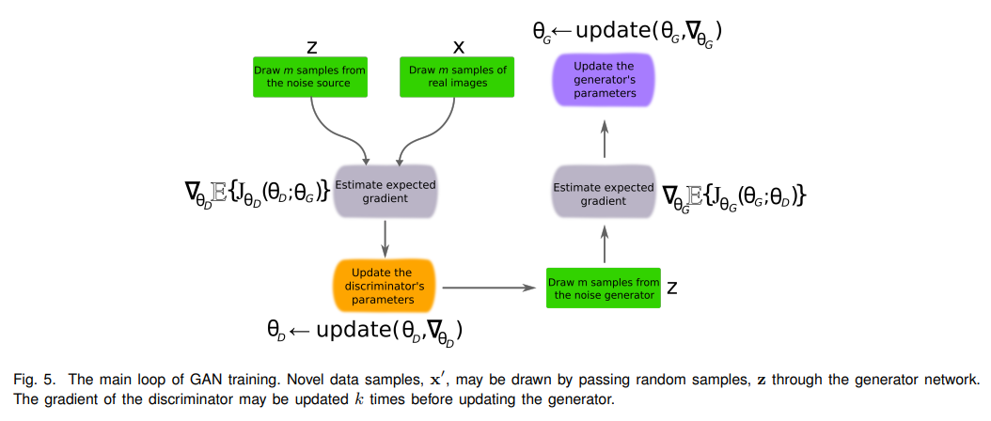
How does this work?

Slide 87
How does this work?
“GANs build their own representations of the data they are trained on, and in doing so produce structured geometric vector spaces for different domains. This is a quality shared with other neural network models, including VAEs [23], as well as linguistic models such as word2vec [34].”

Slide 88
Major Types of GANs (As of 2017)
“The first GAN architectures used fully connected neural networks for both the generator and discriminator [1]. This type of architecture was applied to relatively simple image datasets, namely MNIST (hand written digits), CIFAR-10 (natural images) and the Toronto Face Dataset (TFD).”

Slide 89
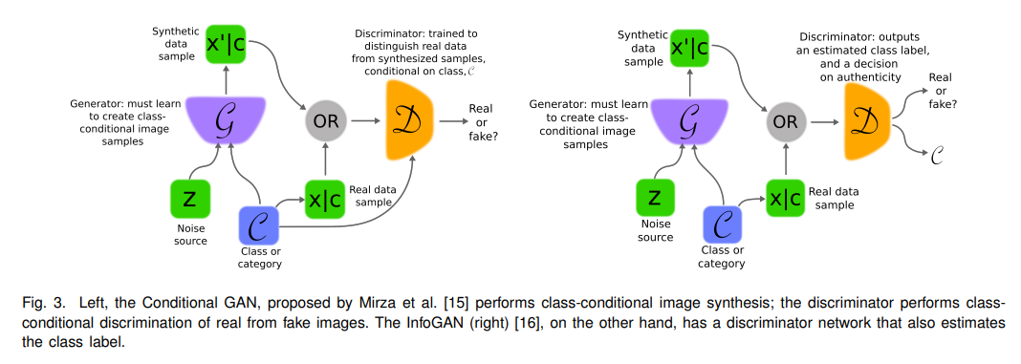
Major Types of GANs (As of 2017)
Convolutional GANs
Capacity issues arose – people worked around with modified versions that create multiple sub-models at different scales (Laplacian pyramid of adversarial network, Deep Convolutional GAN)…
Conditional GANs, InfoGAN

Slide 90
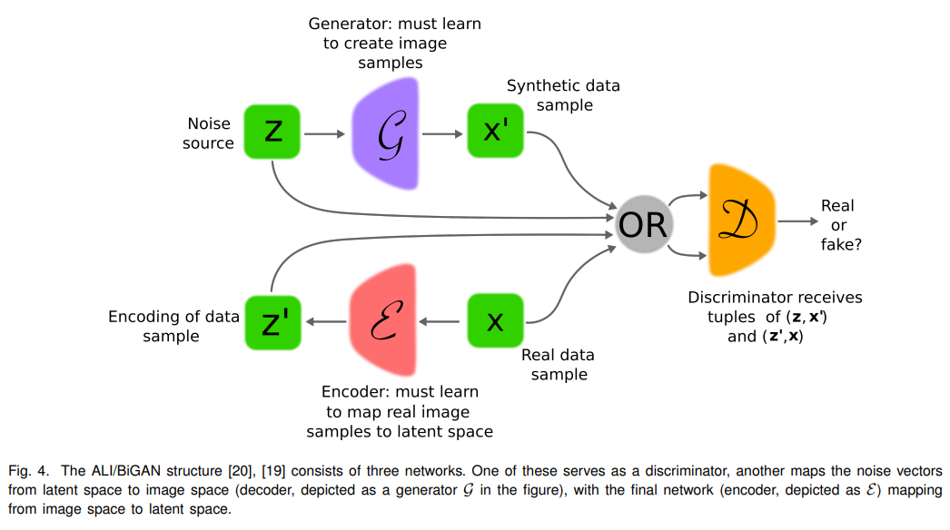

Major Types of GANs (As of 2017)
Adversarially Learned Inference (ALI) / Bidirectional GANs (BiGAN)

Slide 91
Major Types of GANs (As of 2017)
Adversarial Autoencoders (AAE)
“Autoencoders are networks, composed of an “encoder” and “decoder”, that learn to map data to an internal latent representation and out again. “

Slide 92
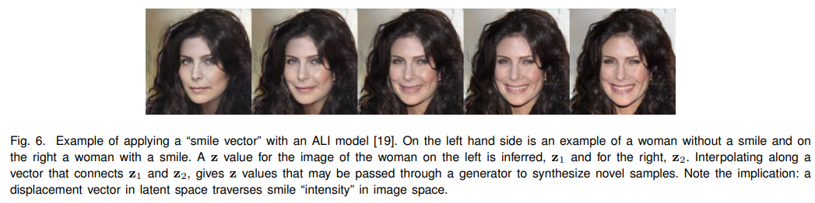
Image Generation

Slide 93
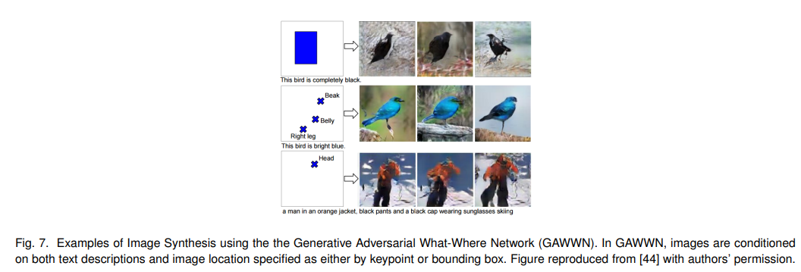
Image Generation

Slide 94
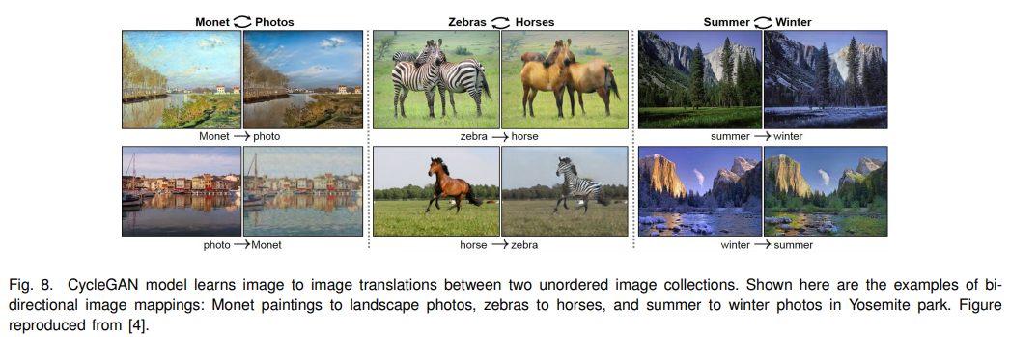

Image Generation

Slide 95
Wednesday

Slide 96

Course Logistics
Friday, March 24 – No Lecture, Extra OH (or meet about your Projects)!
Problem Set 4 – Due Friday, March 24
That’s right before Spring Break!
PS5 will be available over Spring Break, but Spring Break is not part of the expected weeks of completion time
Participation to launch today (due after Spring Break, but don’t sleep on it!)
How did you feel about the SVM Participation’s flexibility?
Project Milestone 3 – On Canvas!

Slide 97
Coding Neural Nets
Participation 10

Slide 98
Reinforcement Learning
How to learn everything in one lecture*

Slide 99
Reinforcement Learning in One Class
IMPOSSIBLE!
There are books on the subject
- Reinforcement Learning: An Introduction – Sutton & Barto
- http://incompleteideas.net/book/the-book.html

Slide 100
Our Typical ML Models
Fitting our Model to Training Data
- Fitting Decision Boundary
- Finding weights, biases, etc.
- Finding Similar Examples

Slide 101

A Different Kind of Problem…
Notes:
https://assetstorev1-prd-cdn.unity3d.com/key-image/3887a860-dbac-447f-8358-732a955e0e19.jpg

Slide 102

A Different Kind of Problem…
Notes:
http://incompleteideas.net/book/bookdraft2017nov5.pdf

Slide 103
A Different Kind of Problem…
Complex decisions
Multi-step activity
steps are not independent
Multiple (Opposing) Players
Notes:
https://assetstorev1-prd-cdn.unity3d.com/key-image/3887a860-dbac-447f-8358-732a955e0e19.jpg

Slide 104
Examples of this Problem
Games – board (chess, go, others), video (adventure, strategy, others)
Stock Investing
Autonomous Vehicles
Others…

Slide 105

Defining Our Problem Space
Agent – A decision-making entity

Slide 106
Defining Our Problem Space
Agent – A decision-making entity
Environment – The space in which the Agent is making decisions

Slide 107
Defining Our Problem Space
Agent – A decision-making entity
Environment – The space in which the Agent is making decisions
State – The current status of the Environment

Slide 108

Defining Our Problem Space
Agent – A decision-making entity
Environment – The space in which the Agent is making decisions
State – The current status of the Environment
Goal – An eventual outcome sought by the Agent

Slide 109
Defining Our Problem Space
Agent – A decision-making entity
Environment – The space in which the Agent is making decisions
State – The current status of the Environment
Goal – An eventual outcome sought by the Agent
Reward – An intermediate measure of success / failure towards the Goal

Slide 110
Defining Our Problem Space
Agent – A decision-making entity
Environment – The space in which the Agent is making decisions
State (S) – The current status of the Environment
Goal – An eventual outcome sought by the Agent
Reward (R) – Intermediate measure of success/failure towards the Goal
Action (A) – The options available to the Agent to change the State

Slide 111

Action & State are Linked
What’s possible? vs
What’s effective?

Slide 112


Markov Decision Processes
Notes:
http://incompleteideas.net/book/bookdraft2017nov5.pdf

Slide 113
Action + State = Policy
Policy (π) – The mapping of state to action

Slide 114
Expanding Reward
Reward – An intermediate measure of success / failure towards the Goal

Slide 115
Expanding Reward
Reward – An intermediate measure of success / failure towards the Goal
Immediate & Future Rewards must both be considered

Slide 116
Expanding Reward
Reward – An intermediate measure of success / failure towards the Goal
Immediate & Future Rewards must both be considered
Value (V) – The expected long-term return based on an action from this current state

Slide 117

Expanding Reward
Reward – An intermediate measure of success / failure towards the Goal
Immediate & Future Rewards must both be considered
Value (V) – The expected long-term return of the current state (in terms of our policy π)
V(S) = Immediate Reward +
(Future Reward * Discount Factor)

Slide 118
Dealing with Value
A variety of factors can be given positive value
- distance to target

Slide 119
Dealing with Value
A variety of factors can be given positive value
- distance to target
- existing intermediate rewards
- chess: removing an enemy piece
- video game: coin, powerup

Slide 120
Dealing with Value
A variety of factors can be given negative value
- bad “goals”
- game over, putting yourself into checkmate

Slide 121
Dealing with Value
A variety of factors can be given negative value
- bad “goals”
- game over, putting yourself into checkmate
- bad intermediate moves
- losing a piece

Slide 122
Dealing with Value
A variety of factors can be given negative value
- bad “goals”
- game over, putting yourself into checkmate
- bad intermediate moves
- losing a piece
- effort
- any move can have cost

Slide 123

Dealing with Value
Black is considering two options
- Knight to F2
- Queen to D5
What happens if we value capturing pieces highly?
What happens if we avoid risk?

Slide 124

Expected Value
$G=my \text{(}\text{expected}\text{) }\text{total} \text{return} \text{for} \text{an} \text{action} \text{at} \text{time} \text{t}$
$r=my immediate reward$
$γ=my discount factor \left[0−1\right]$
$T=the time to spend on my task$
$$G_{t}= \sum_{j=0}^{T}{γ^{j}r_{t+j+1}}$$

Slide 125
Dealing with Value
Black is considering two options
- Knight to F2
- Queen to D5
What happens if we value capturing pieces highly?
What happens if we avoid risk?
What happens 5 moves out???

Slide 126
Expanding Reward
Each possible action can generate a Value (V)

Slide 127
Expanding Reward
Each possible action can generate a Value (V)
Q-Value is the long-term return of a (State, Action) pair

Slide 128


Bellman Equations: Value
$$V_{π}\left(s\right)=\sum_{a}{π(a|s)}∙ \sum_{s′}{P_{ss^{′}}^{a}(r\left(s,a\right)+γV_{π}\left(s′\right)}$$
https://towardsdatascience.com/the-bellman-equation-59258a0d3fa7

Slide 129

Bellman Equations: Q
$$Q_{π}\left(s,a\right)=\sum_{s′}{P_{ss^{′}}^{a}(r\left(s,a\right)+γV_{π}\left(s^{′}\right))}$$
https://towardsdatascience.com/the-bellman-equation-59258a0d3fa7

Slide 130
Q ~ Decision Boundary
Q maps state + action = reward
From a state, choose the action with the best Q Value!

Slide 131
Q ~ Decision Boundary
Q maps state + action = reward
From a state, choose the action with the best Q Value!

Slide 132
Q ~ Final Model
Q maps state + action = reward
From a state, choose the action with the best Q Value!

Slide 133
Developing Q

Slide 134
Developing Q
We have two feature sets to optimize
- Values for states
- Policies for how to act

Slide 135
Developing Q
We have two feature sets to optimize
- Values for states
- Policies for how to act
à la Backpropagation, let’s iterate through each one in turn!

Slide 136


Developing Q – a Probabilistic Approach
Consider a maze world. How will our agent get from start to goal, without hitting doom?

Slide 137
Developing Q – a Probabilistic Approach
Consider a maze world. How will our agent get from start to goal, without hitting doom?
(Yes, we could write a set of instructions for this world. But it could get too complicated, especially in a bigger world!)

Slide 138
Developing Q – a Probabilistic Approach
Consider a maze world. How will our agent get from start to goal, without hitting doom?
Move at random into a new space!

Slide 139

Developing Q – Updating Value
Notes:
https://www.cin.ufpe.br/~tfl2/artificial-intelligence-modern-approach.9780131038059.25368.pdf

Slide 140
Developing Q – Updating Value
Calculate out the probability of success or failure at each point
Notes:
https://www.cin.ufpe.br/~tfl2/artificial-intelligence-modern-approach.9780131038059.25368.pdf

Slide 141
Developing Q – Updating Value
Calculate out the probability of success or failure at each point
Notes:
https://www.cin.ufpe.br/~tfl2/artificial-intelligence-modern-approach.9780131038059.25368.pdf

Slide 142
Developing Q – Updating Value
Calculate out the probability of success or failure at each point
Notes:
https://www.cin.ufpe.br/~tfl2/artificial-intelligence-modern-approach.9780131038059.25368.pdf

Slide 143

Developing Q – Updating Policy
You can use this approach to feed back into your decision policies!
Notes:
https://www.cin.ufpe.br/~tfl2/artificial-intelligence-modern-approach.9780131038059.25368.pdf

Slide 144
Problems to Address
Dealing with the problem of scale
Choosing our “features” to represent state
- easy in games, hard in the real world
Generalization

Slide 145

Dealing with Scale
How many States are there in the game of chess?
Notes:
https://math.stackexchange.com/questions/1406919/how-many-legal-states-of-chess-exists

Slide 146
Dealing with Scale
How many States are there in the game of chess?
7.7 * 10⁴⁵ according to John Tromp…
How much memory storage do you have?
Notes:
https://math.stackexchange.com/questions/1406919/how-many-legal-states-of-chess-exists

Slide 147
Dealing with Scale
How many States are there in the game of chess?
7.7 * 10⁴⁵ according to John Tromp…
How much memory storage do you have?
5e11(500 GB)? 1e12(1TB)?
We’re not approaching the storage capacity to actually hold all states!
Notes:
https://math.stackexchange.com/questions/1406919/how-many-legal-states-of-chess-exists

Slide 148

Scale – Monte Carlo Estimation
Instead of mapping out the full probability space, let’s generate a bunch of sample uses of our policy (to end-state) and use the outcomes to determine value!
Notes:
https://thumbs.gfycat.com/BetterThankfulEnglishsetter-max-1mb.gif

Slide 149

Developing Q – Monte Carlo

Slide 150

Updating Q
$$Q_{new}\left(s_{t},a_{t}\right)=r_{t}+\max_{a}{Q_{old}\left(s_{t},a_{t}\right)}$$
$$for the state−action pairs seen in my trial$$

Slide 151


Monte Carlo vs. Temporal Difference

